Slide 1

6th Grade Math
Unit 11, Lesson 1 Evaluating Expressions Volume 2, pg. 239

Slide 2


Benchmark
MA.6.AR.1.3
Evaluate algebraic expressions using substitution and order of operations
volume 2, pg. 239

Slide 3
Integrated Mathematical Thinking and Reasoning Standards
MA.K12.MTR.4.1 Engage in discussions that reflect on the mathematical thinking of self and others.
MA.K12.MTR.5.1 Use patterns and structure to help understand and connect mathematical concepts.
volume 2, pg. 239

Slide 4

Learning Target
I can apply order of operations to an algebraic expression.
volume 2, pg. 239

Slide 5

Warm-Up
volume 2, pg. 239

Slide 6
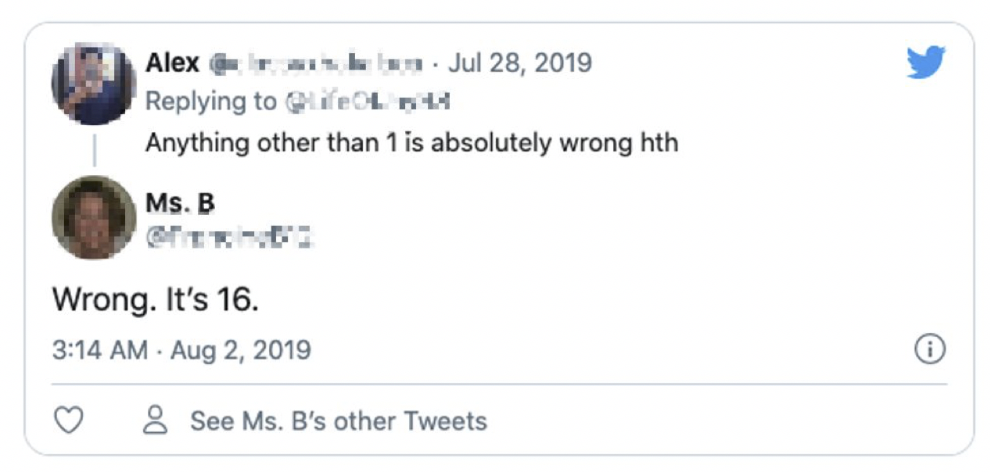
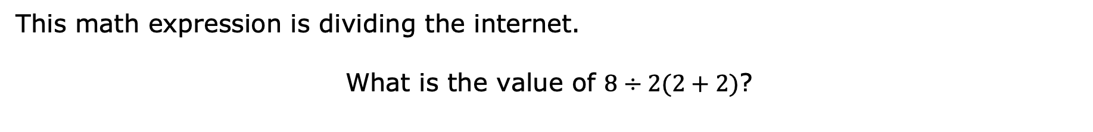
11.1.1 Warm-Up: Evaluating Numeric Expressions
This math expression is dividing the internet.
What is the value of $8÷2(2+2)$?
volume 2, pg. 239

Slide 7

Do you agree with Alex or Ms. B? Explain or show why using order of operations.
Find the value of the expression. Show your work.
$$4−2×6÷3+7$$
volume 2, pg. 239

Slide 8

Collaboration
volume 2, pg. 240

Slide 9

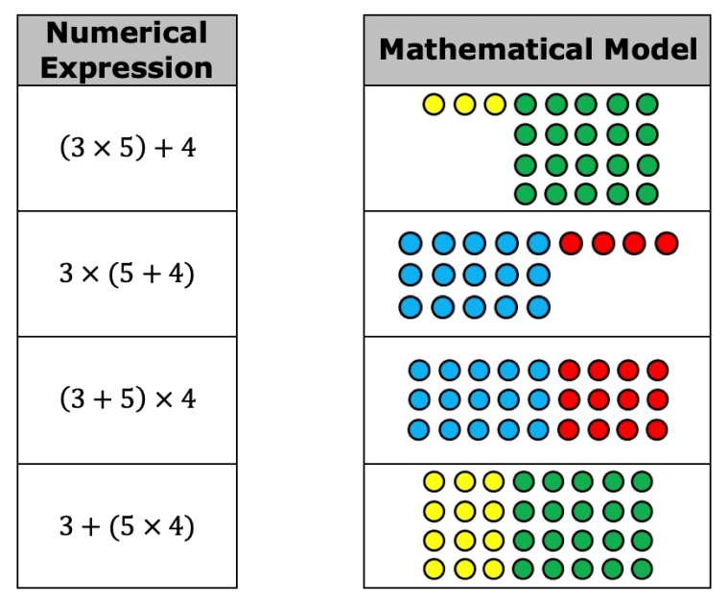
11.1.2 Collaboration: Modeling the Meaning of Expressions
Work with your partner to determine which mathematical model matches each numerical expression. Use arrows to indicate matches. Be prepared to explain your thinking.
How did you use the grouping symbols to help you determine which model matched each expression?
volume 2, pg. 240

Slide 10
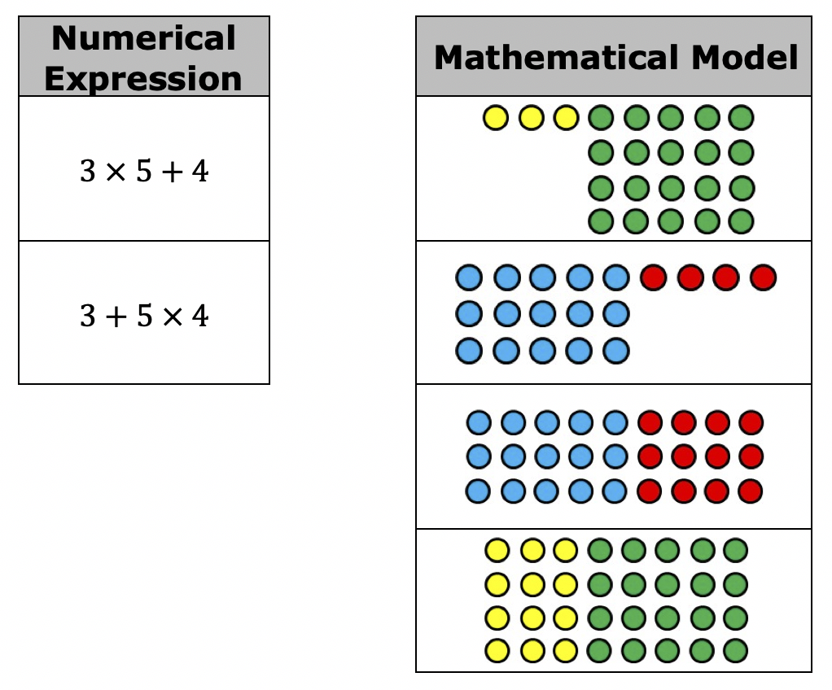
If the grouping symbols were removed, which model matches each expression? Use arrows to indicate matches.
volume 2, pg. 240

Slide 11

Guided Instruction
volume 2, pg. 241

Slide 12
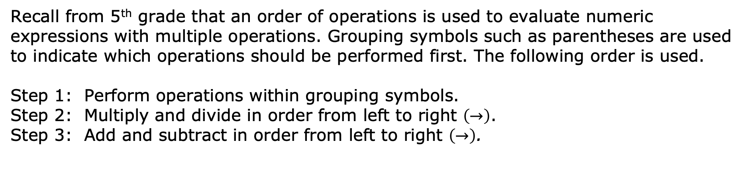
11.1.3 Guided Instruction: Applying Order of Operations to Algebraic Expressions
Recall from 5th grade that an order of operations is used to evaluate numeric expressions with multiple operations. Grouping symbols such as parentheses are used to indicate which operations should be performed first. The following order is used.
Step 1: Perform operations within grouping symbols.
Step 2: Multiply and divide in order from left to right $\left(→\right)$.
Step 3: Add and subtract in order from left to right $\left(→\right)$.
volume 2, pg. 241

Slide 13
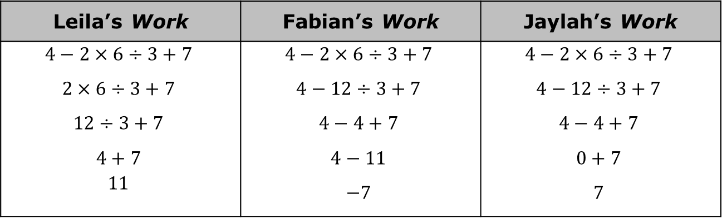
Three students completed the warm-up. The steps in each student’s process are shown.
Leila’s Work | Fabian’s Work | Jaylah’s Work
$$4−2×6÷3+7$$ $$2×6÷3+7$$ $$12÷3+7$$ $$4+7$$ $$11$$ | $$4−2×6÷3+7$$ $$4−12÷3+7$$ $$4−4+7$$ $$4−11$$ $$−7$$ | $$4−2×6÷3+7$$ $$4−12÷3+7$$ $$4−4+7$$ $$0+7$$ $$7$$
volume 2, pg. 241

Slide 14
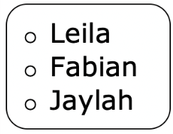
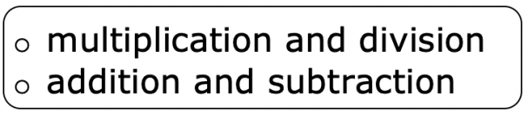
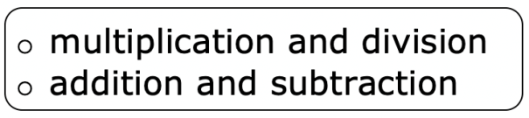
Complete the statements about which student correctly applied the given steps of the order of operations.
evaluated the numerical expression correctly.
She first performed all in order
from left to right and then performed all
in order from left to right.
volume 2, pg. 241

Slide 15
With your partner, discuss the work of each student, Leila, Fabian, and Jaylah. Two of these students made a mistake somewhere. Circle the mistakes that you and your partner found.
volume 2, pg. 241

Slide 16

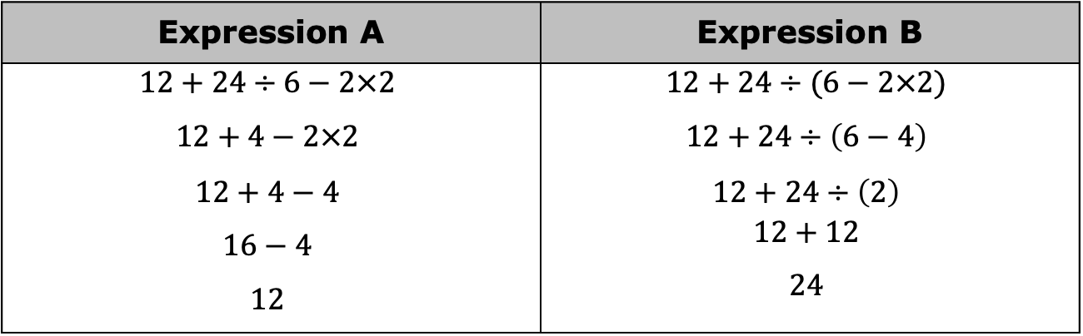
Omari evaluated Expression A and Expression B. His work is shown.
With your partner, discuss the two original expressions that Omari evaluated and his corresponding answers.
Omari’s partner gave him a on both of his answers. Why did Omari arrive at two different values when evaluating these expressions?
Expression A | Expression B
$$12+24÷6−2×2$$ $$12+4−2×2$$ $$12+4−4$$ $$16−4$$ $$12$$ | $$12+24÷(6−2×2)$$ $$12+24÷\left(6−4\right)$$ $$12+24÷\left(2\right)$$ $$12+12$$ $$24$$
volume 2, pg. 241

Slide 17
Like numeric expressions, algebraic expressions can be evaluated using order of operations when given a specific value for the variable(s).
In an algebraic expression, a variable is a letter that represents a number. It is called a variable because the value used to replace the letter can vary.
volume 2, pg. 241

Slide 18


When evaluating algebraic expressions, first substitute the given ________ for the variable(s). Then, apply the given steps for order of operations.
Evaluate $\frac{n}{6}+2$ when $n=12$.
In mathematics, evaluate is an instruction that indicates the answer is a value.
volume 2, pg. 242

Slide 19

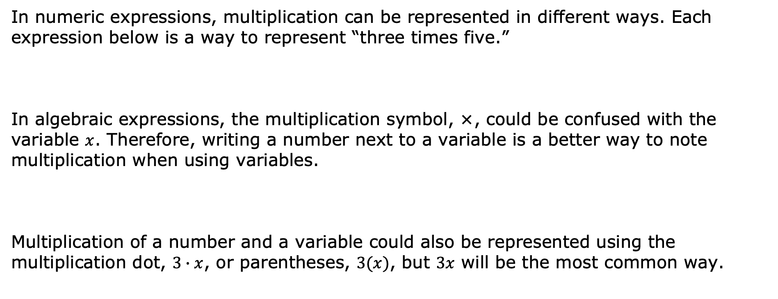
In numeric expressions, multiplication can be represented in different ways. Each expression below is a way to represent “three times five.”
In algebraic expressions, the multiplication symbol, ×, could be confused with the variable $x$. Therefore, writing a number next to a variable is a better way to note multiplication when using variables.
Multiplication of a number and a variable could also be represented using the multiplication dot, $3∙x$, or parentheses, $3(x)$, but $3x$ will be the most common way.
$$3×5$$ | $$3∙5$$ | $$3(5)$$
$3x$ means “three times $x$.”
volume 2, pg. 242

Slide 20

Explain why $3∙5$ cannot be written as $35$.
What is the value of $3x$ if $x=5$?
Find the value of $7m−(3+b−12)÷2$ if $m=4$ and
$b=15$. Show your work.
When substituting values into algebraic expressions, it is helpful to put the substituted value in parentheses when the variable is being multiplied by a known value.
volume 2, pg. 242

Slide 21

Guided Practice
volume 2, pg. 243

Slide 22

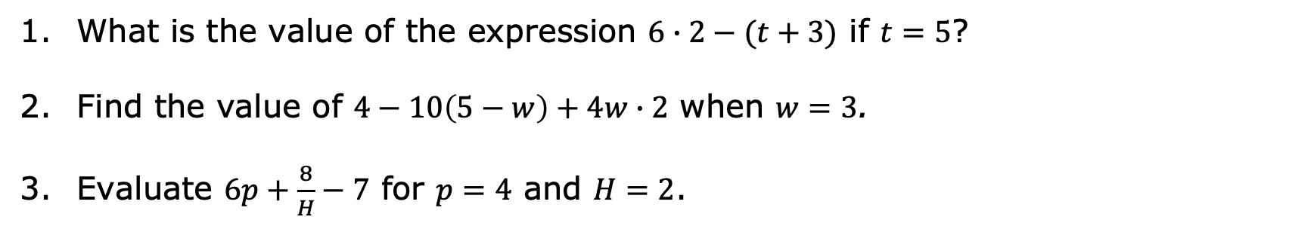
11.1.4 Guided Practice: Evaluating Algebraic Expressions
What is the value of the expression $6∙2−(t+3)$ if $t=5$?
Find the value of $4−10\left(5−w\right)+4w∙2$ when $w=3$.
Evaluate $6p+\frac{8}{H}−7$ for $p=4$ and $H=2$.
volume 2, pg. 243

Slide 23

Your Turn
volume 2, pg. 243

Slide 24
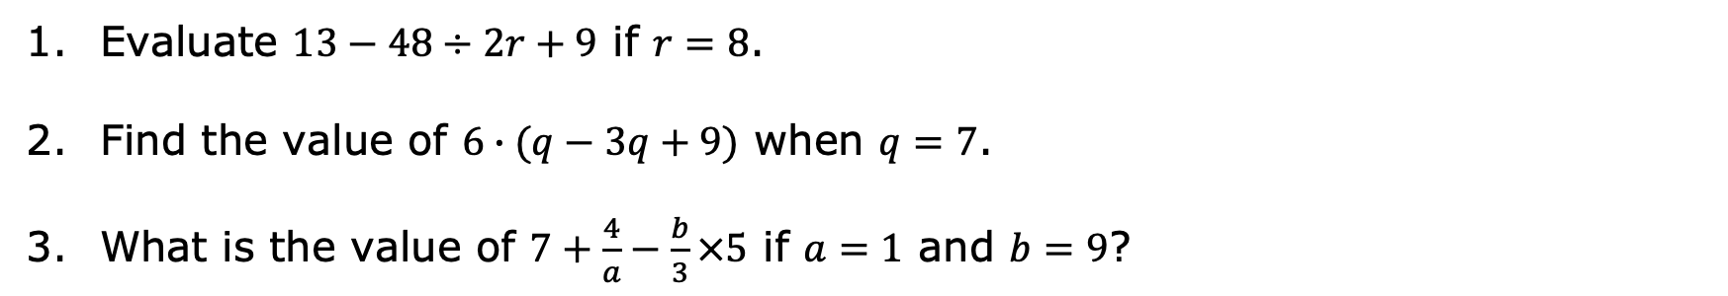
11.1.5 Your Turn!
Evaluate $13−48÷2r+9$ if $r=8$.
Find the value of $6∙(q−3q+9)$ when $q=7$.
What is the value of $7+\frac{4}{a}−\frac{b}{3}×5$ if $a=1$ and $b=9$?
volume 2, pg. 243

Slide 25

Wrap-Up
volume 2, pg. 244

Slide 26
11.1.6 Wrap-Up: Ticket Out the Door
Evaluate $8a+3b\left(2a−4\right)$ for $a=2$ and $b=6$.
volume 2, pg. 244

